Slide 1

CHAPTER 3
CONDUCTING BUSINESS
ETHICALLY AND SOCIALLY RESPONSIBLY
Copyright © 2014 Pearson Canada Inc.
3-<number>

Slide 2
Learning Objectives
1. Explain how individuals develop their personal codes of ethics and why ethics are important in the workplace.
2. Distinguish corporate social responsibility from ethics, identify organizational stakeholders, and characterize social consciousness today.
3. Show how the concept of social responsibility applies both to environmental issues and to a firm’s relationships with customers, employees, and investors.
Copyright © 2014 Pearson Canada Inc.
3-<number>
Notes:
2
2
These learning objectives are based upon those at the beginning of the chapter. For a review of learning objectives, see the summary at the end of the chapter, as well as the list of key terms.

Slide 3
Learning Objectives
4. Identify four general approaches to social responsibility and describe the four steps a firm must take to implement a social responsibility program.
5. Explain how issues of social responsibility and ethics affect small businesses.
Copyright © 2014 Pearson Canada Inc.
3-<number>
Notes:
2
2
These learning objectives are based upon those at the beginning of the chapter. For a review of learning objectives, see the summary at the end of the chapter, as well as the list of key terms.

Slide 4
Ethics in the Workplace
(LO 3-1)
What Is Ethical Behaviour? (Copying textbooks?)
Ethics
  standards or moral values that dictate what is right and wrong
  culturally based
  formed upon society’s expectations
  vary by person, and by situation
  Influenced by family, faith, etc.
Everyone develops his/her own “code of ethics”
Copyright © 2014 Pearson Canada Inc.
3-<number>
Notes:
4
4
Learning Objective: 3-1
Notes
This introduction to ethics provides some basic definitions and stresses that what constitutes ethical behaviour is to a great extent open to discussion.
Activities
Building Your Business Skills
Discuss how students have developed their own ideas of what is right and wrong. Do they believe ethics can be taught?

Slide 5
Unethical vs Illegal
What’s the difference?
Examples?
© 2014 Pearson Education Ltd.
3-<number>

Slide 6
Ethics in the Workplace
(LO 3-1)
Influences on Ethical Behaviour
Peer Group
Family
Experiences
Personal Code of Ethics
Copyright © 2014 Pearson Canada Inc.
3-<number>
Notes:
5
5
Learning Objective: 3-1
Notes
The discussion in the text demonstrates the key determinants of individual ethics. Care must be taken to put the lesson in the context of the situation facing the individual making ethical decisions.
Activities
Discuss how students have developed their own ideas of what is right and wrong. Do they believe ethics can be taught?

Slide 7
In-Class Activity
In groups, pick a topic or 2 from the ones listed and discuss your responses
Present to class
https://www.psychologytoday.com/us/blog/how-do-life/201706/ethical-dilemmas
You run an orphanage and have had a hard time making ends meet. A car dealership offers you a new van worth $15,000 for free if you will falsely report to the government that the dealership donated a van worth $30,000. You really need the van and it will give you an opportunity to make the children happy. Do you agree to take the van?
© 2014 Pearson Education Ltd.
3-<number>

Slide 8
In-Class Activity Cont’d
3. https://robohub.org/an-ethical-dilemma-when-robot-cars-must-kill-who-should-pick-the-victim/
4. You’re asked to lose files needed in investigation
https://www.itworldcanada.com/blog/the-top-7-ethical-dilemmas-reported-by-it-in-2016/389838
5. Find your own topic through research
© 2014 Pearson Education Ltd.
3-<number>

Slide 9
Ethics in the Workplace
(LO 3-1)
Managerial ethics are the standards of behaviour that guide managers in their work
Behaviour toward employees – hiring family & friends
Behaviour toward the organization – padding expense accounts, stealing supplies; accepting gifts (conflict of interest)
Behaviour toward other economic entities – firm vs customers, shareholders, suppliers, competitors, culturally-sanctioned bribes
Copyright © 2014 Pearson Canada Inc.
3-<number>
Notes:
6
6
Learning Objective: 3-1
Activities
Questions for Analysis #2

Slide 10
Ethics in the Workplace
(LO 3-1)
Assessing Ethical Behaviour
Gather the relevant factual information
Analyze the facts to determine the most appropriate moral values
Make an ethical judgment based on the rightness or wrongness of the proposed activity or policy
Copyright © 2014 Pearson Canada Inc.
3-<number>
Notes:
Learning Objective: 3-1
Figure 3.1

Slide 11
Ethics in the Workplace
(LO 3-1)
Assessing Ethical Behaviour
Utility
  Does the act epitomize what is best for those who are affected by it?
Rights
  Does it respect the rights of the individuals involved?
Justice
  Is it consistent with what we regard as fair?
Caring
  Is it consistent with people’s responsibilities to others?
How did you make your ethical judgments in the previous exercise?
Copyright © 2014 Pearson Canada Inc.
3-<number>
Notes:
Learning Objective: 3-1
Figure 3.1
Activities
Questions for Analysis #1

Slide 12
Ethics in the Workplace
(LO 3-1)
Company practices and business ethics – Ponzi schemes, emailing your direct reports pretending to be a recruiter with a job offer
Adopt a Written Code of Ethics!
  Increase public confidence in a firm or its industry
  Help stem the tide of government regulation
  Improve internal operations by providing consistent standards of both ethical and legal conduct
  Help managers respond to problems that arise as a result of unethical or illegal behaviour
Copyright © 2014 Pearson Canada Inc.
3-<number>
Notes:
Learning Objective: 3-1
Figure 3.2

Slide 13
Social Responsibility
(LO 3-2)
A business’s collective code of ethics toward its stakeholders
customers
employees
investors
suppliers
local community
Copyright © 2014 Pearson Canada Inc.
3-<number>
Notes:
Learning Objective: 3-2
Figure 3.4
Notes
Care should be taken to clarify how every action taken by a business can be perceived as socially responsible or not. All stakeholders must be treated equally where ethical behaviour is concerned. Care to treat one sector responsibly is not effective if other stakeholders are suffering.
Activities
Questions for Analysis #5
Application Exercise #1

Slide 14
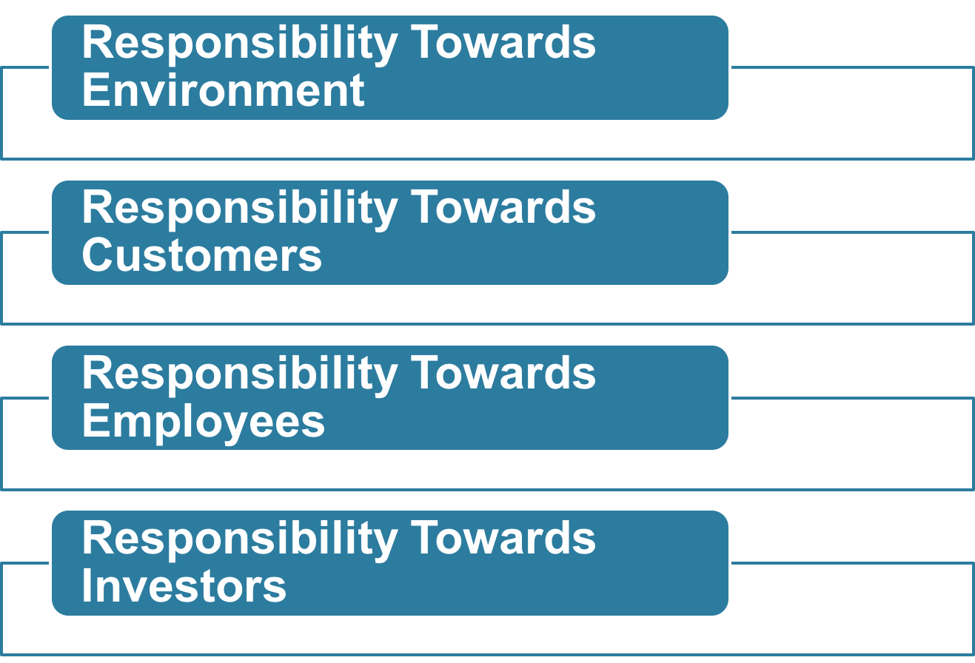
Areas of Social Responsibility (LO 3-3)
Copyright © 2014 Pearson Canada Inc.
3-<number>
Notes:
8
8
Learning Objective: 3-3
Activities
Analysis Questions #4, #6
Application Exercises #1

Slide 15
Areas of Social Responsibility
(LO 3-3)
Responsibility toward the Environment
Air pollution
Water pollution
Land pollution
  toxic waste disposal
  recycling
Copyright © 2014 Pearson Canada Inc.
3-<number>
Notes:
Learning Objective: 3-3
Figure 3.5
Case 3-1, 3-2
Notes
All of the environmental issues listed above occur due to emissions from automobiles and/or manufacturing plants. Much of Canada’s pollution is a result of America’s businesses.
Legislation has been introduced to force clean up in some industries. In other cases, special interest groups are working to protect the environment against exploitation. However, in some industries the cost of the technology to clean up emissions is so great that it would force businesses out of business. This in itself is an ethical quandary.

Slide 16
Areas of Social Responsibility
(LO 3-3)
Responsibility toward Customers
Rights of consumers
  Consumerism seeks to protect and expand the rights of consumers in their dealings with businesses
Unfair pricing
  collusion
Ethics in advertising https://www.businessinsider.com/false-advertising-scandals-2016-3
  truth in advertising
  advertising of counterfeit brands
  morally objectionable advertising
Copyright © 2014 Pearson Canada Inc.
3-<number>
Notes:
Learning Objective: 3-3
Notes
Companies have two key areas which require interaction with customers. These areas are pricing and product. Responsibility to customers is concerned with the fair and ethical treatment of buyers in each of these areas.

Slide 17
Areas of Social Responsibility
(LO 3-3)
Rights of Consumers
Right to safe products
Right to be informed about all relevant aspects of a product
Right to be heard
Right to choose what they buy
Right to be educated about purchases
Right to courteous service
Copyright © 2014 Pearson Canada Inc.
3-<number>
Notes:
16
16
Learning Objective: 3-3

Slide 18
Areas of Social Responsibility
(LO 3-3)
Responsibility toward Employees
Legal and social commitments
  human resource management issues
  social responsibility issues
  privacy issues
    drug testing and computer monitoring
  encouraging ethical behaviour
    whistle-blowers
Copyright © 2014 Pearson Canada Inc.
3-<number>
Notes:
18
18
Learning Objective: 3-3
Activities
Questions for Analysis #3

Slide 19
Areas of Social Responsibility
(LO 3-3)
Responsibility toward Investors
Improper financial management
Kiting cheques
Insider trading
Misrepresentation of finances
Copyright © 2014 Pearson Canada Inc.
3-<number>
Notes:
Learning Objective 3-3

Slide 20
Areas of Social Responsibility
(LO 3-3)
Improper Financial Management
  Doing a poor job of managing the financial resources of a company
  May be legally unpunishable because no law has been broken
  It may be difficult to replace management because unrest in the firm may devalue its stock
Copyright © 2014 Pearson Canada Inc.
3-<number>
Notes:
24
24
Learning Objective: 3-3

Slide 21
Areas of Social Responsibility
(LO 3-3)
Cheque Kiting
  Illegal practice of writing cheques against money that has not yet arrived in the bank account
  A creative “cheque kiter” can write cheques from account to account with very little money to back it up
  The assumption is that the money will arrive before the cheque needs to clear
Copyright © 2014 Pearson Canada Inc.
3-<number>
Notes:
25
25
Learning Objective: 3-3
Notes
Cheque kiting s not the same as post-dating a cheque, whereby the cheque is dated for the day the money will actually arrive in the account (post-dating is not illegal as the bank will hold the cheque until the processing date). It is important that students understand the difference.

Slide 22
Areas of Social Responsibility
(LO 3-3)
Insider Trading
  Using confidential (non-public) information to gain from the sale of stock
  Involves gaining knowledge of inside information about the company prior to making the purchase
  Can involve the collusion of investors buying and selling stock at the appropriate time to make huge profits
Copyright © 2014 Pearson Canada Inc.
3-<number>
Notes:
26
26
Learning Objective: 3-3
Notes
The only way the perpetrators know when the time is right for purchase or sale is through information they are not allowed to have, which other investors have no legal access to.

Slide 23
Areas of Social Responsibility (LO 3-3)
Misrepresentation of Finances
  Companies must conform to accounting guidelines called generally accepted accounting principles (GAAP)
  Failure to follow GAAP in order to inflate expected profit figures can mislead investors
Copyright © 2014 Pearson Canada Inc.
3-<number>
Notes:
27
27
Learning Objective: 3-3

Slide 24
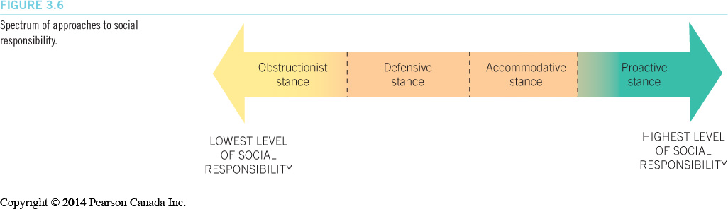
Implementing Social Responsibility Programs (LO 3-4)
Approaches to Corporate Social Responsibility
Copyright © 2014 Pearson Canada Inc.
3-<number>
Notes:
29
29
Learning Objective: 3-4
Figure 3.6
Notes
Social responsible behaviour is as hard to classify as ethical behaviour. The material in the text does an excellent job of demonstrating various “degrees” of social responsibility and the effects that the degrees have on the social mandate of an organization.
Obstructionist Stance: a company does as little as possible to solve social or environmental problems.
Defensive Stance: a company does only what is legally required and nothing more.
Accommodative Stance: a company meets all legal obligations and in some cases goes beyond what is required.
Proactive Stance: an organization seeks opportunities to be socially responsible (overcomes problems before they even occur).
Activities
Questions for Analysis #6
Application Exercises #2

Slide 25
Implementing Social Responsibility Programs (LO 3-4)
Corporate Charitable Donations
  80% of companies said that they made contributions because it was the right thing to do, not just for financial gain
  Corporations often donate goods when disaster strikes
  Many encourage their employees to volunteer at community activities
  Better solution? Michael Porter’s Shared Value https://www.youtube.com/watch?v=xuG-1wYHOjY
Copyright © 2014 Pearson Canada Inc.
3-<number>
Notes:
Learning Objective: 3-4
Notes
Corporations typically give < ½% of pre-tax profits to charity. It is recommended that they give at least 1%
The majority of money given to charities is from individuals, not corporations
Activity
Ask students to debate whether or not companies should donate money. Who does it affect? What other ways can a company give to the community?

Slide 26
Implementing Social Responsibility Programs (LO 3-4)
Managing Social Responsibility Programs
Top management support
Strategic planning
Appointment of a director
Social audit
Social responsibility
Copyright © 2014 Pearson Canada Inc.
3-<number>
Notes:
Learning Objective: 3-4
Figure 3.7

Slide 27
Implementing Social Responsibility Programs (LO 3-4)
Step 1: Top Management Support
  Top management support is essential to adopting a social responsibility program
  Top managers must develop a policy statement outlining their commitment to more ethical behaviour
Copyright © 2014 Pearson Canada Inc.
3-<number>
Notes:
34
34
Learning Objective: 3-4

Slide 28
Implementing Social Responsibility Programs (LO 3-4)
Step 2: Strategic Planning
  Top managers develop a plan of the level of company support toward goals of social responsibility
    percentage of sales revenues to go to social causes
    promise to train chronically unemployed people
Copyright © 2014 Pearson Canada Inc.
3-<number>
Notes:
35
35
Learning Objective: 3-4

Slide 29
Implementing Social Responsibility Programs (LO 3-4)
Step 3: Appoint a Director
  An executive-level administrator must be appointed to oversee the social program that the firm has created
  This may be achieved through a partial time work commitment on the part of existing top managers
Copyright © 2014 Pearson Canada Inc.
3-<number>
Notes:
36
36
Learning Objective: 3-4

Slide 30
Implementing Social Responsibility Programs (LO 3-4)
Step 4: The Social Audit
  A systematic analysis of how the firm is using funds designated specifically to fund its social initiatives
  Also addresses the effectiveness of the monies that have been spent
  Triple bottom line reporting =
    financial reports, social audits and sustainability reports
Copyright © 2014 Pearson Canada Inc.
3-<number>
Notes:
37
37
Learning Objective:3-4

Slide 31
Social Responsibility and The Small Business (LO 3-5)
A small business does not have the same impact on society if it acts in an irresponsible way
Many entrepreneurs decide to conduct themselves in a socially responsible manner because they feel it is important to contribute to society
Individual entrepreneurs make independent decisions
Copyright © 2014 Pearson Canada Inc.
3-<number>
Notes:
38
38
Learning Objective: 3-5
Notes
The structure and focus of a small business make it difficult to follow the social responsibility model. Many times, the small business consists of too few employees. Their personal codes of ethics will likely be the basis of the small business’s ethical and social orientations.
Activities
Assign the students to a major non-profit, charitable organization. Ask the students to identify major sponsors. Then, have the students identify which of the benefactors are small businesses and not large corporations. Based on this analysis, do the students feel that small businesses are socially responsible?
Question for Analysis #5

